Slide 1
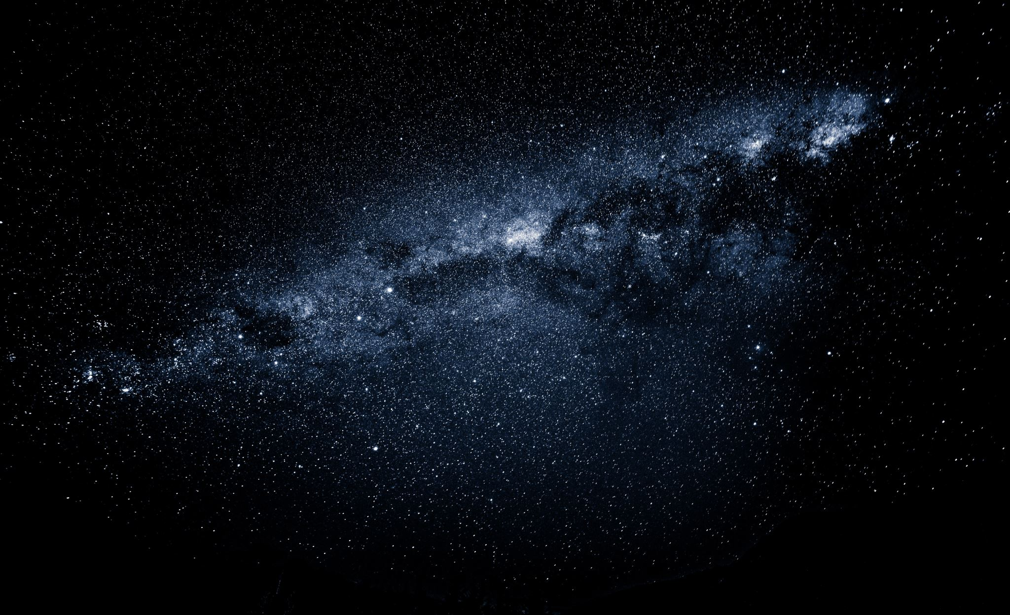
A Simulation of the Solar System
Computational Physics
Mathilde Simoni

Slide 2
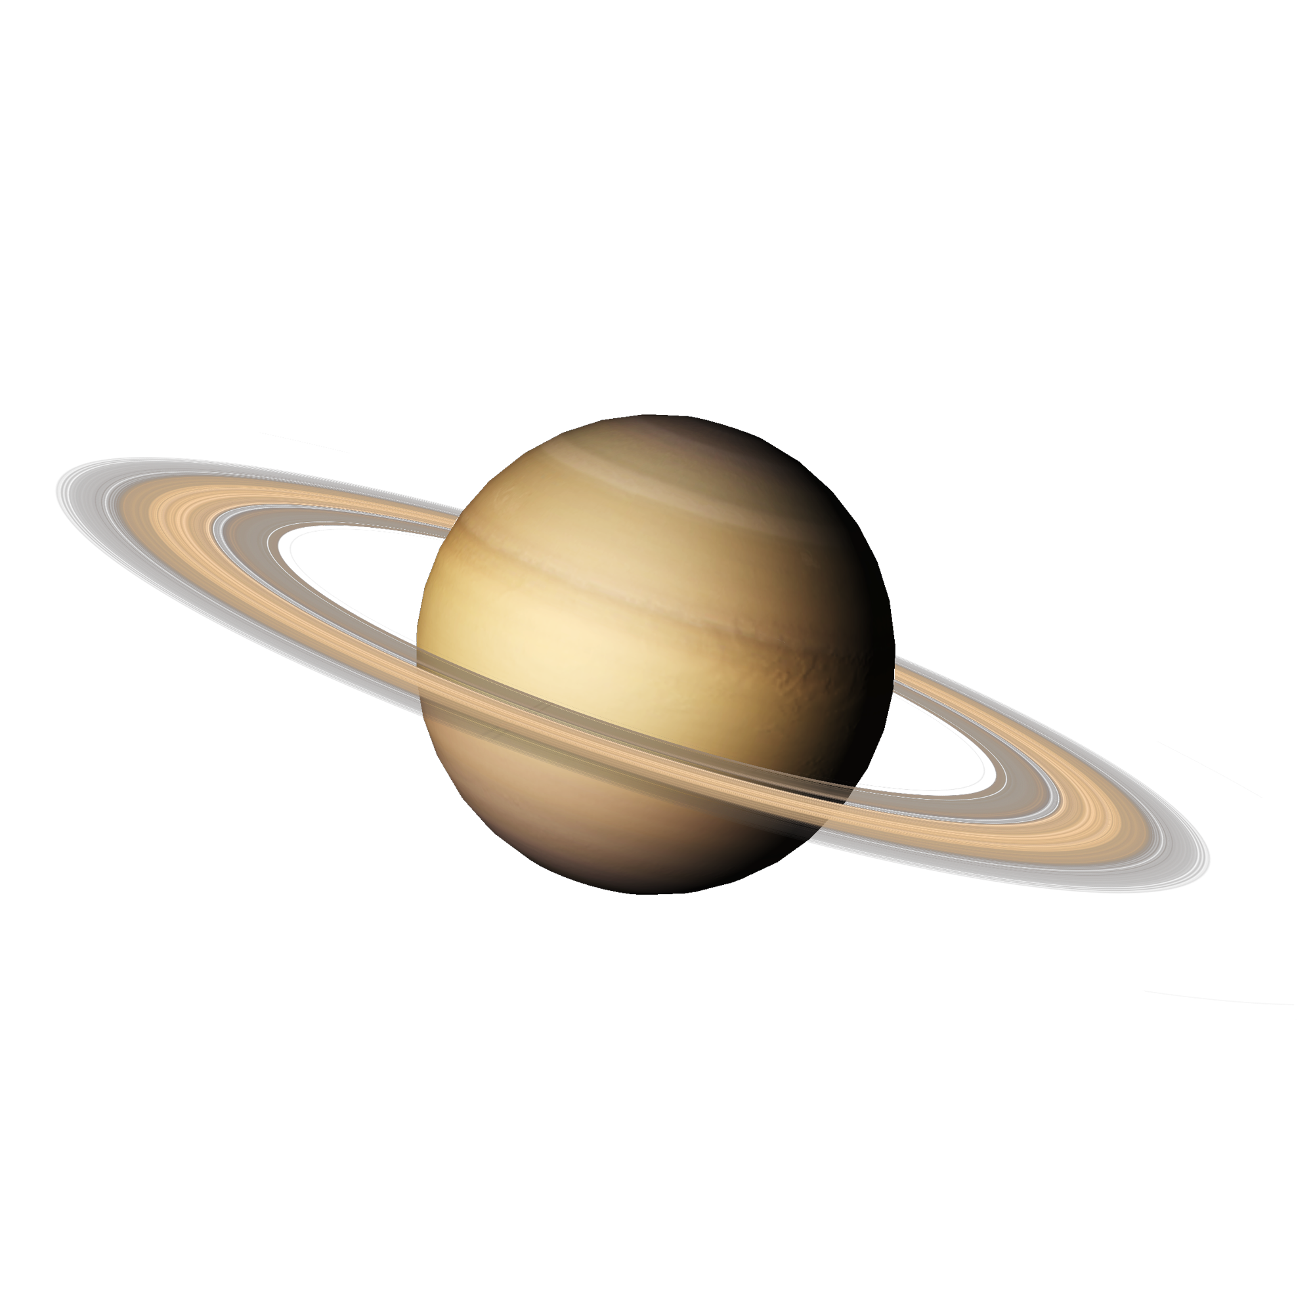
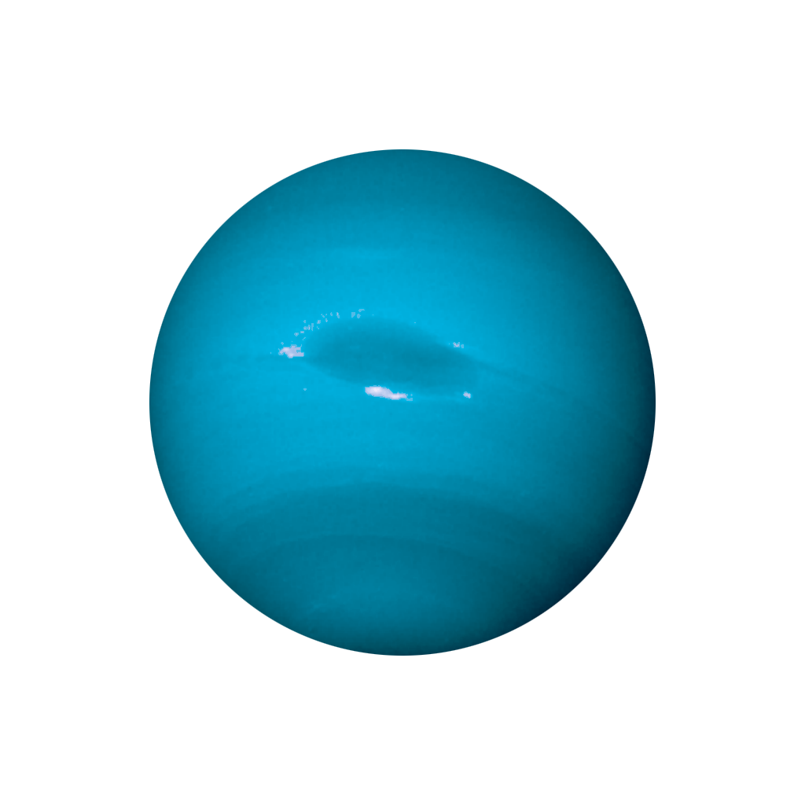
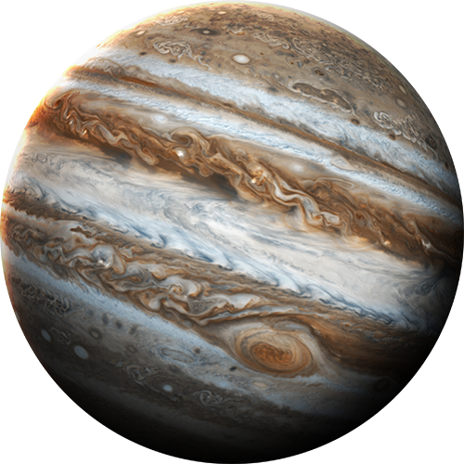
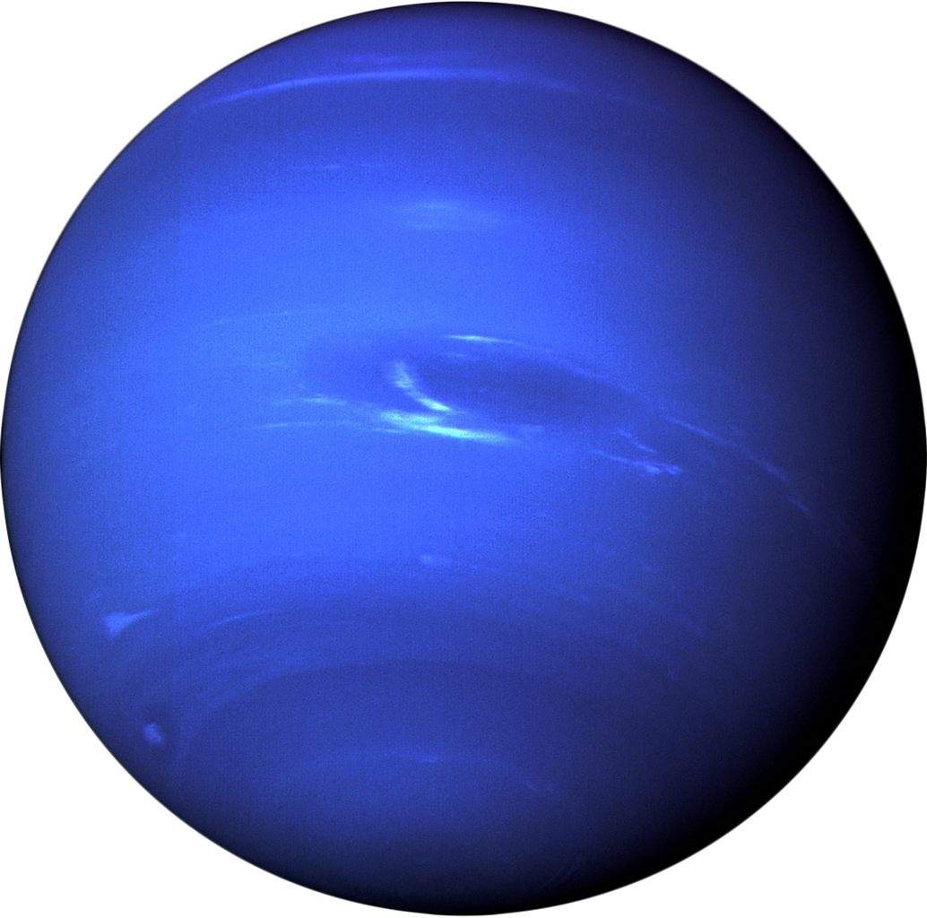
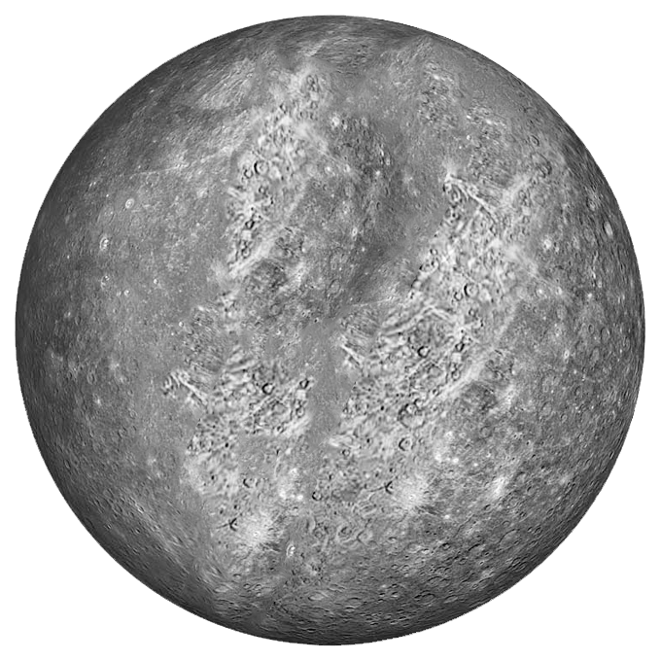
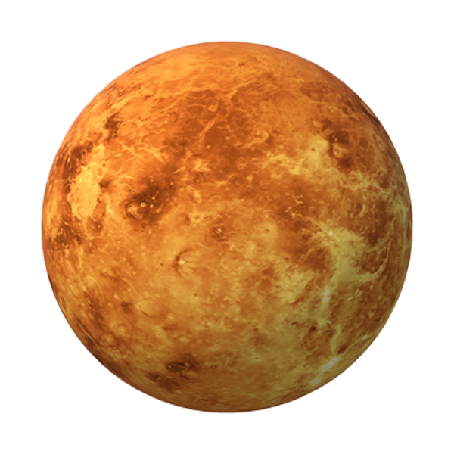

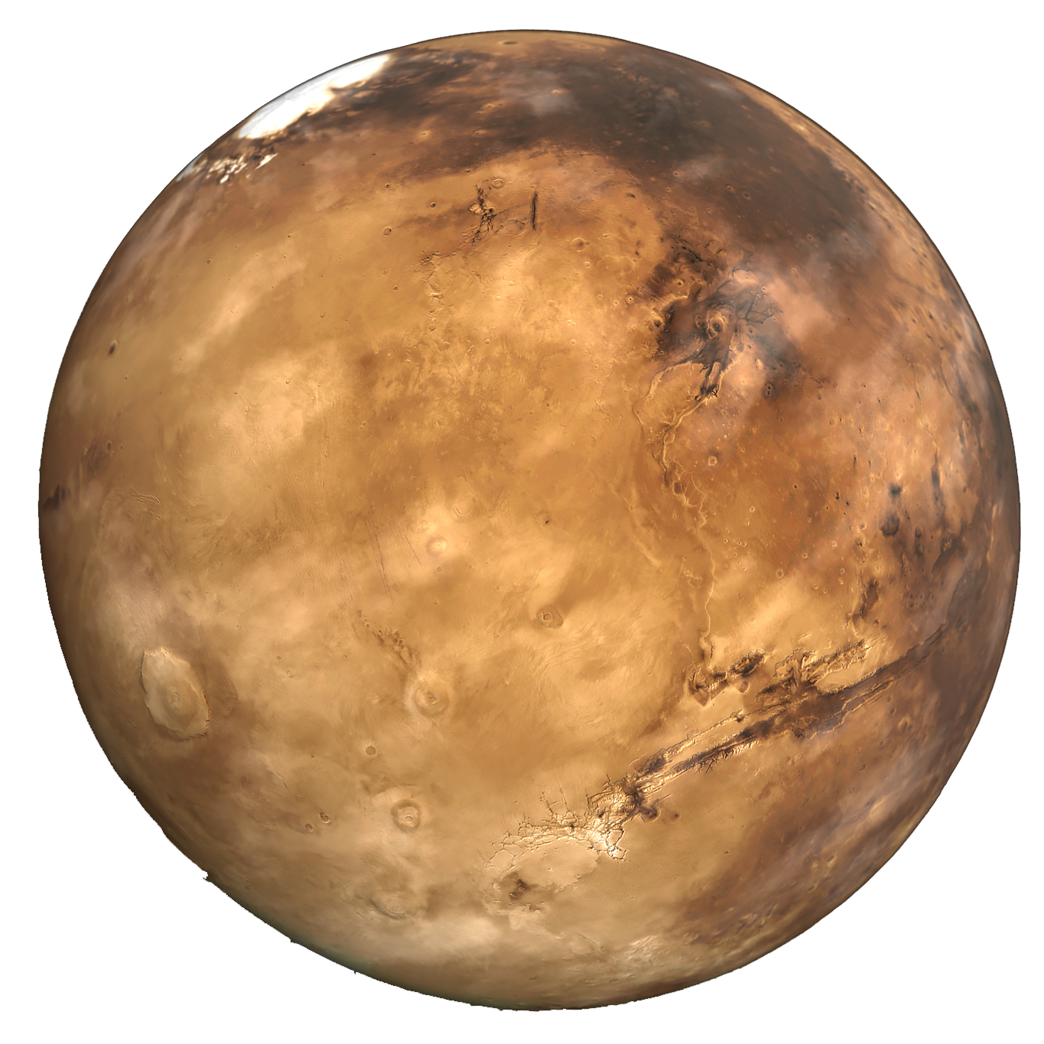
Background
The n body problem refers to understanding how n particles (or celestial bodies) interact with each other with the influence of gravity only. Bodies have arbitrary masses, initial velocities, and positions and interact through Newton's law of gravitation.
NO analytical solutions for systems with 3 bodies or more!
Solar System: special case of the n body problem with 9 bodies (Sun + 8 planets)
Investigate the past and questions of stability:
Will current planets' configurations be maintained in the future,
or will planets eventually leave their orbits, be lost from the system,
and alter other planets' trajectories?
Notes:
Presentation n-body problem
Numerical solutions have been developped: computationally very expensive (n^2): involves pairwise interaction between n bodies
High performance computing has helped overcome this problem of quadratic growth
Special cases:
3 body problem: study the influence of Jupiter on Earth Trajectory
Solar system: 9 bodies, timespen of 4.6 billion years when the solar system was formed (simplified, no moon)

Slide 3






Equations
Notes:
Based on Newton 2nd lay of motion F = ma and law of universal gravitation

Slide 4


Numerical Methods: Fourth-Order Runge-Kutta
The fourth order Runge Kutta Method is an Integration method which has a a fifth order accuracy ($∝Δt^{5}$). It approximates $x\left(t+Δt\right)$from an equation of the form $\frac{∂x}{∂t}=f\left(x,t\right)$in the following way:
$$x_{1}=x\left(t\right)$$ | $$t_{1}=t$$
$$x_{2}=x\left(t\right)+f\left(x_{1},t_{1}\right)\frac{Δt}{2}$$ | $$t_{2}=t+\frac{Δt}{2}$$
$$x_{3}=x\left(t\right)+f\left(x_{2},t_{2}\right)\frac{Δt}{2}$$ | $$t_{3}=t_{2}=t+\frac{Δt}{2}$$
$$x_{4}=x\left(t\right)+f\left(x_{3},t_{3}\right)\frac{Δt}{2}$$ | $t_{4}=t+$ $Δt$
$x\left(t+Δt\right)=x\left(t\right)$ + $\frac{1}{6}[f\left(x_{1},t_{1}\right)+ 2f\left(x_{2}, t_{2}\right)+ 2f\left(x_{3}, t_{3}\right)+ f\left(x_{4}, t_{4}\right)]Δt$
Notes:
- uses 4 approximations to the slope at time t and subsequently calculates weighted sum of these 4 slopes to get the final estimate at time t + ∆t - The idea is that the midpoints slopes (f (x2, t2) and f (x3, t3)) are expected to be better estimates of the actual slope than f (x1, t1) and f (x4, t4), hence their weighting is higher than those at the endpoints

Slide 5


Numerical Methods: Bulirsch-Stoer
Uses the Modified Midpoint Method and Richardson Extrapolation
Modified midpoint method to for $x\left(t+Δt\right)$ when $\frac{∂x}{∂t}=f\left(x,t\right)$:
Split $\left(Δt\right)$ in n intervals of size h and perform:
$$x_{0}=x\left(t\right)$$
$$x_{1}=x_{0}+hf\left(x_{0},t\right)$$
$$x_{2}=x_{0}+2hf\left(x_{1},t+h\right)$$
$$x_{3}=x_{1}+2hf\left(x_{2},t+2h\right)$$
$$x_{4}=x_{2}+2hf\left(x_{3},t+3h\right)$$
…
$$x_{n}=x_{n−2}+2hf\left(x_{n−1},t+(n−1)h\right)$$
$$x\left(t+Δt\right)=\frac{1}{2}\left[x_{n}+x_{n−1}+hf\left(x_{n},t+Δt\right)\right]$$
Extrapolation of a function $F(h)$ with a polynomial of order p:
Suppose $F\left(h\right)=a_{0}+a_{1}h^{p}+O\left(h^{r}\right)$ with $r>p$
$F\left(h\right)=a_{0}+a_{1}h^{p}$
$F\left(\frac{h}{q}\right)=a_{0}+a_{1}{\left(\frac{h}{g}\right)}^{p}$
So $a_{0}=F\left(h\right)+\frac{F\left(h\right)−F\left(\frac{h}{q}\right)}{q^{−p}−1}$
Notes:
The modified midpoint method is a second-order method, hence less accurate than Runga- Kutta, but it only requires one derivative evaluation per step, instead of the two evaluations that Runge-Kutta necessitates, which makes it particularly relevant for Bulirsch-Stoer.
In general, Bulirsch-Stoer consists of using different values of h to approximate x(t + ∆t) with the modified midpoint method. Hence, the interval ∆t is split by an interval consisting of finer and finer steps h.
Richardson extrapolation consists of getting a value for x(t + ∆t) when h → 0 (or n → ∞) by using polynomial extrapolation. For our simulation , we use a linear extrapolation (polynomial of degree 1).

Slide 6
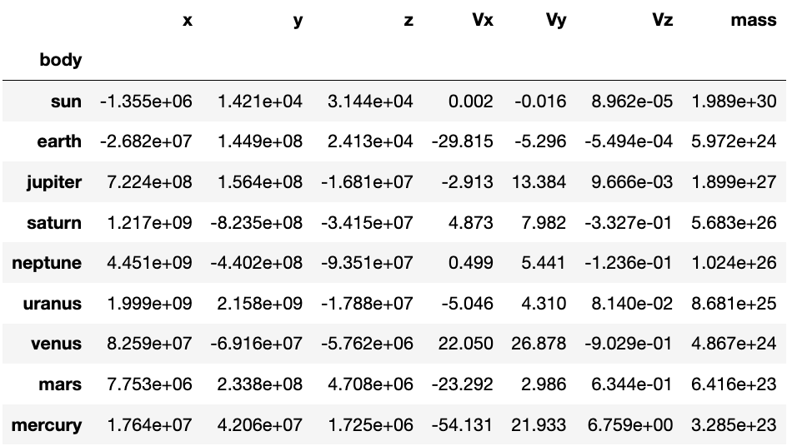
Methodology
Non dimentionalization
1 AU = 1.496 × 108 km
1 year = 3.156 × 107 s
1 M∗ = 1.989 × 1030 kg (mass of the Sun)
Initialization:
We use NASA’s JPL (Jet Propulsion Lab) Horizons database to get the initial conditions of the 9 bodies on January 1st, 1750
Time-steps
0.125, 0.25, 0.5, 1, 2.5 days
Notes:
Simulate on NYUAD’s HPC server Jubail
Time-span: 250 Earth years (until January 1st, 2000
Integration methods: Runga-Kutta and Bulirsch-Stoer
Time-step: 0.125, 0.25, 0.5, 1 day, and 2.5 Earth days

Slide 7
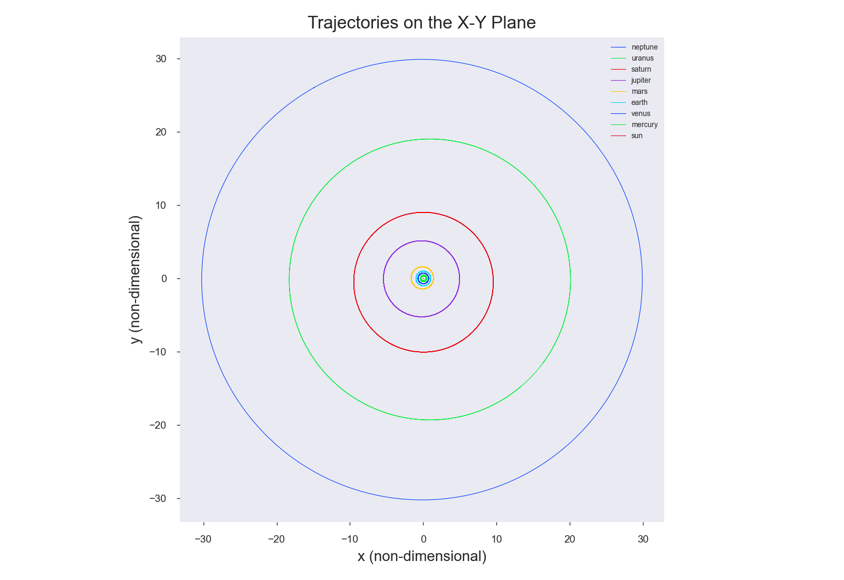
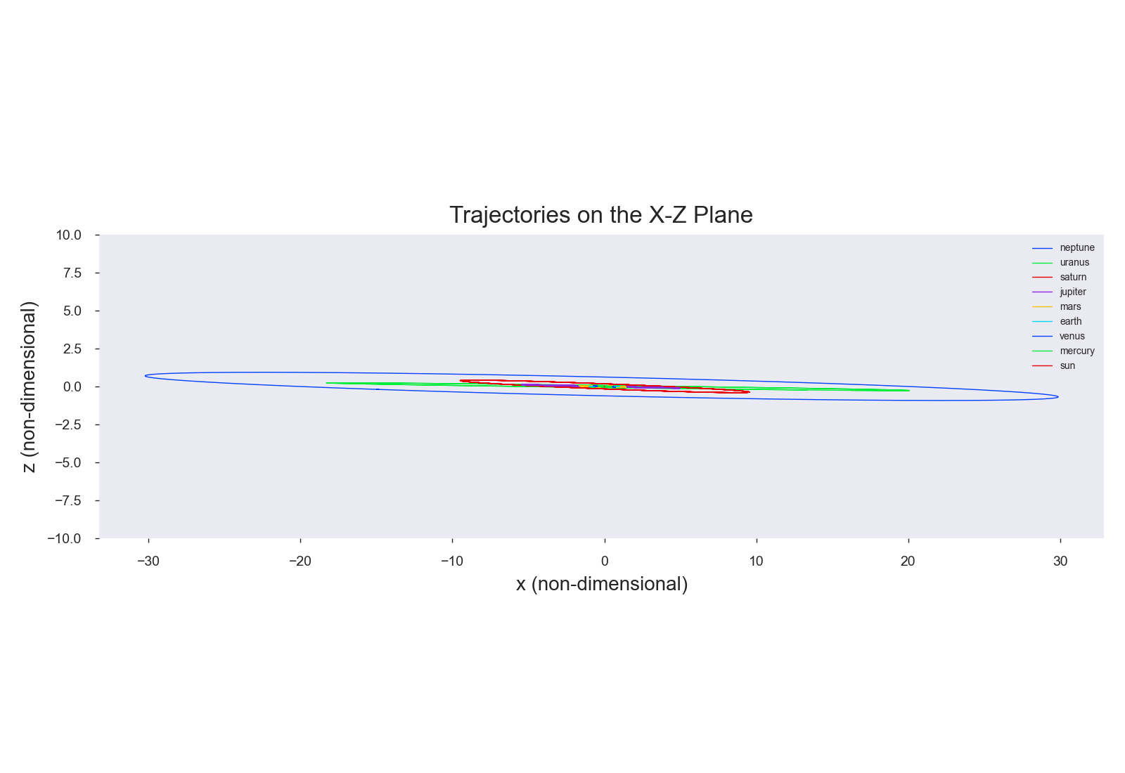
Results: Visualizations
Notes:
Orbits seem to be circular and on the same x-y plane
165 years orbit of Neptune

Slide 8

Notes:
Sizes are not real or we wouldn’t see the planets
The sun emits light
Night sky with shaders: code which apply the same code to every pixel (visual coding on blender)
And then script to import trajectory of planets

Slide 9
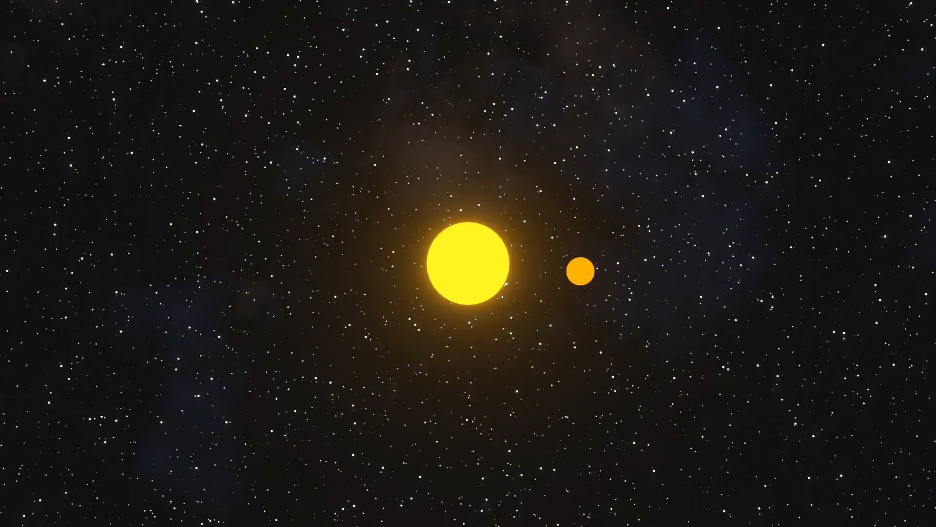

Slide 10
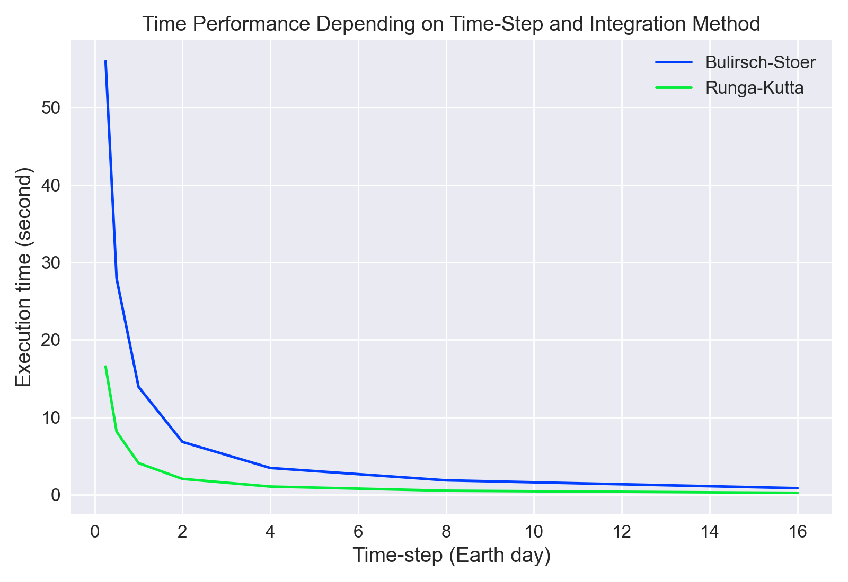
Analysis: Time Performance
Notes:
-For 10 years depending on time step and method used
-Execution time inversly proportional to timestep For example, if the time-step is reduced by 2, the execution time is multiplied by 2.
-In addition, simulations with Runga-Kutta method seem to be consistently faster than simulations with Bulirsch-Stoer. This makes sense as Bulirsch-Stoer uses more intermediate calculations (calculate with midpoint methods for different time intervals) + and a Richardson extrapolation

Slide 11
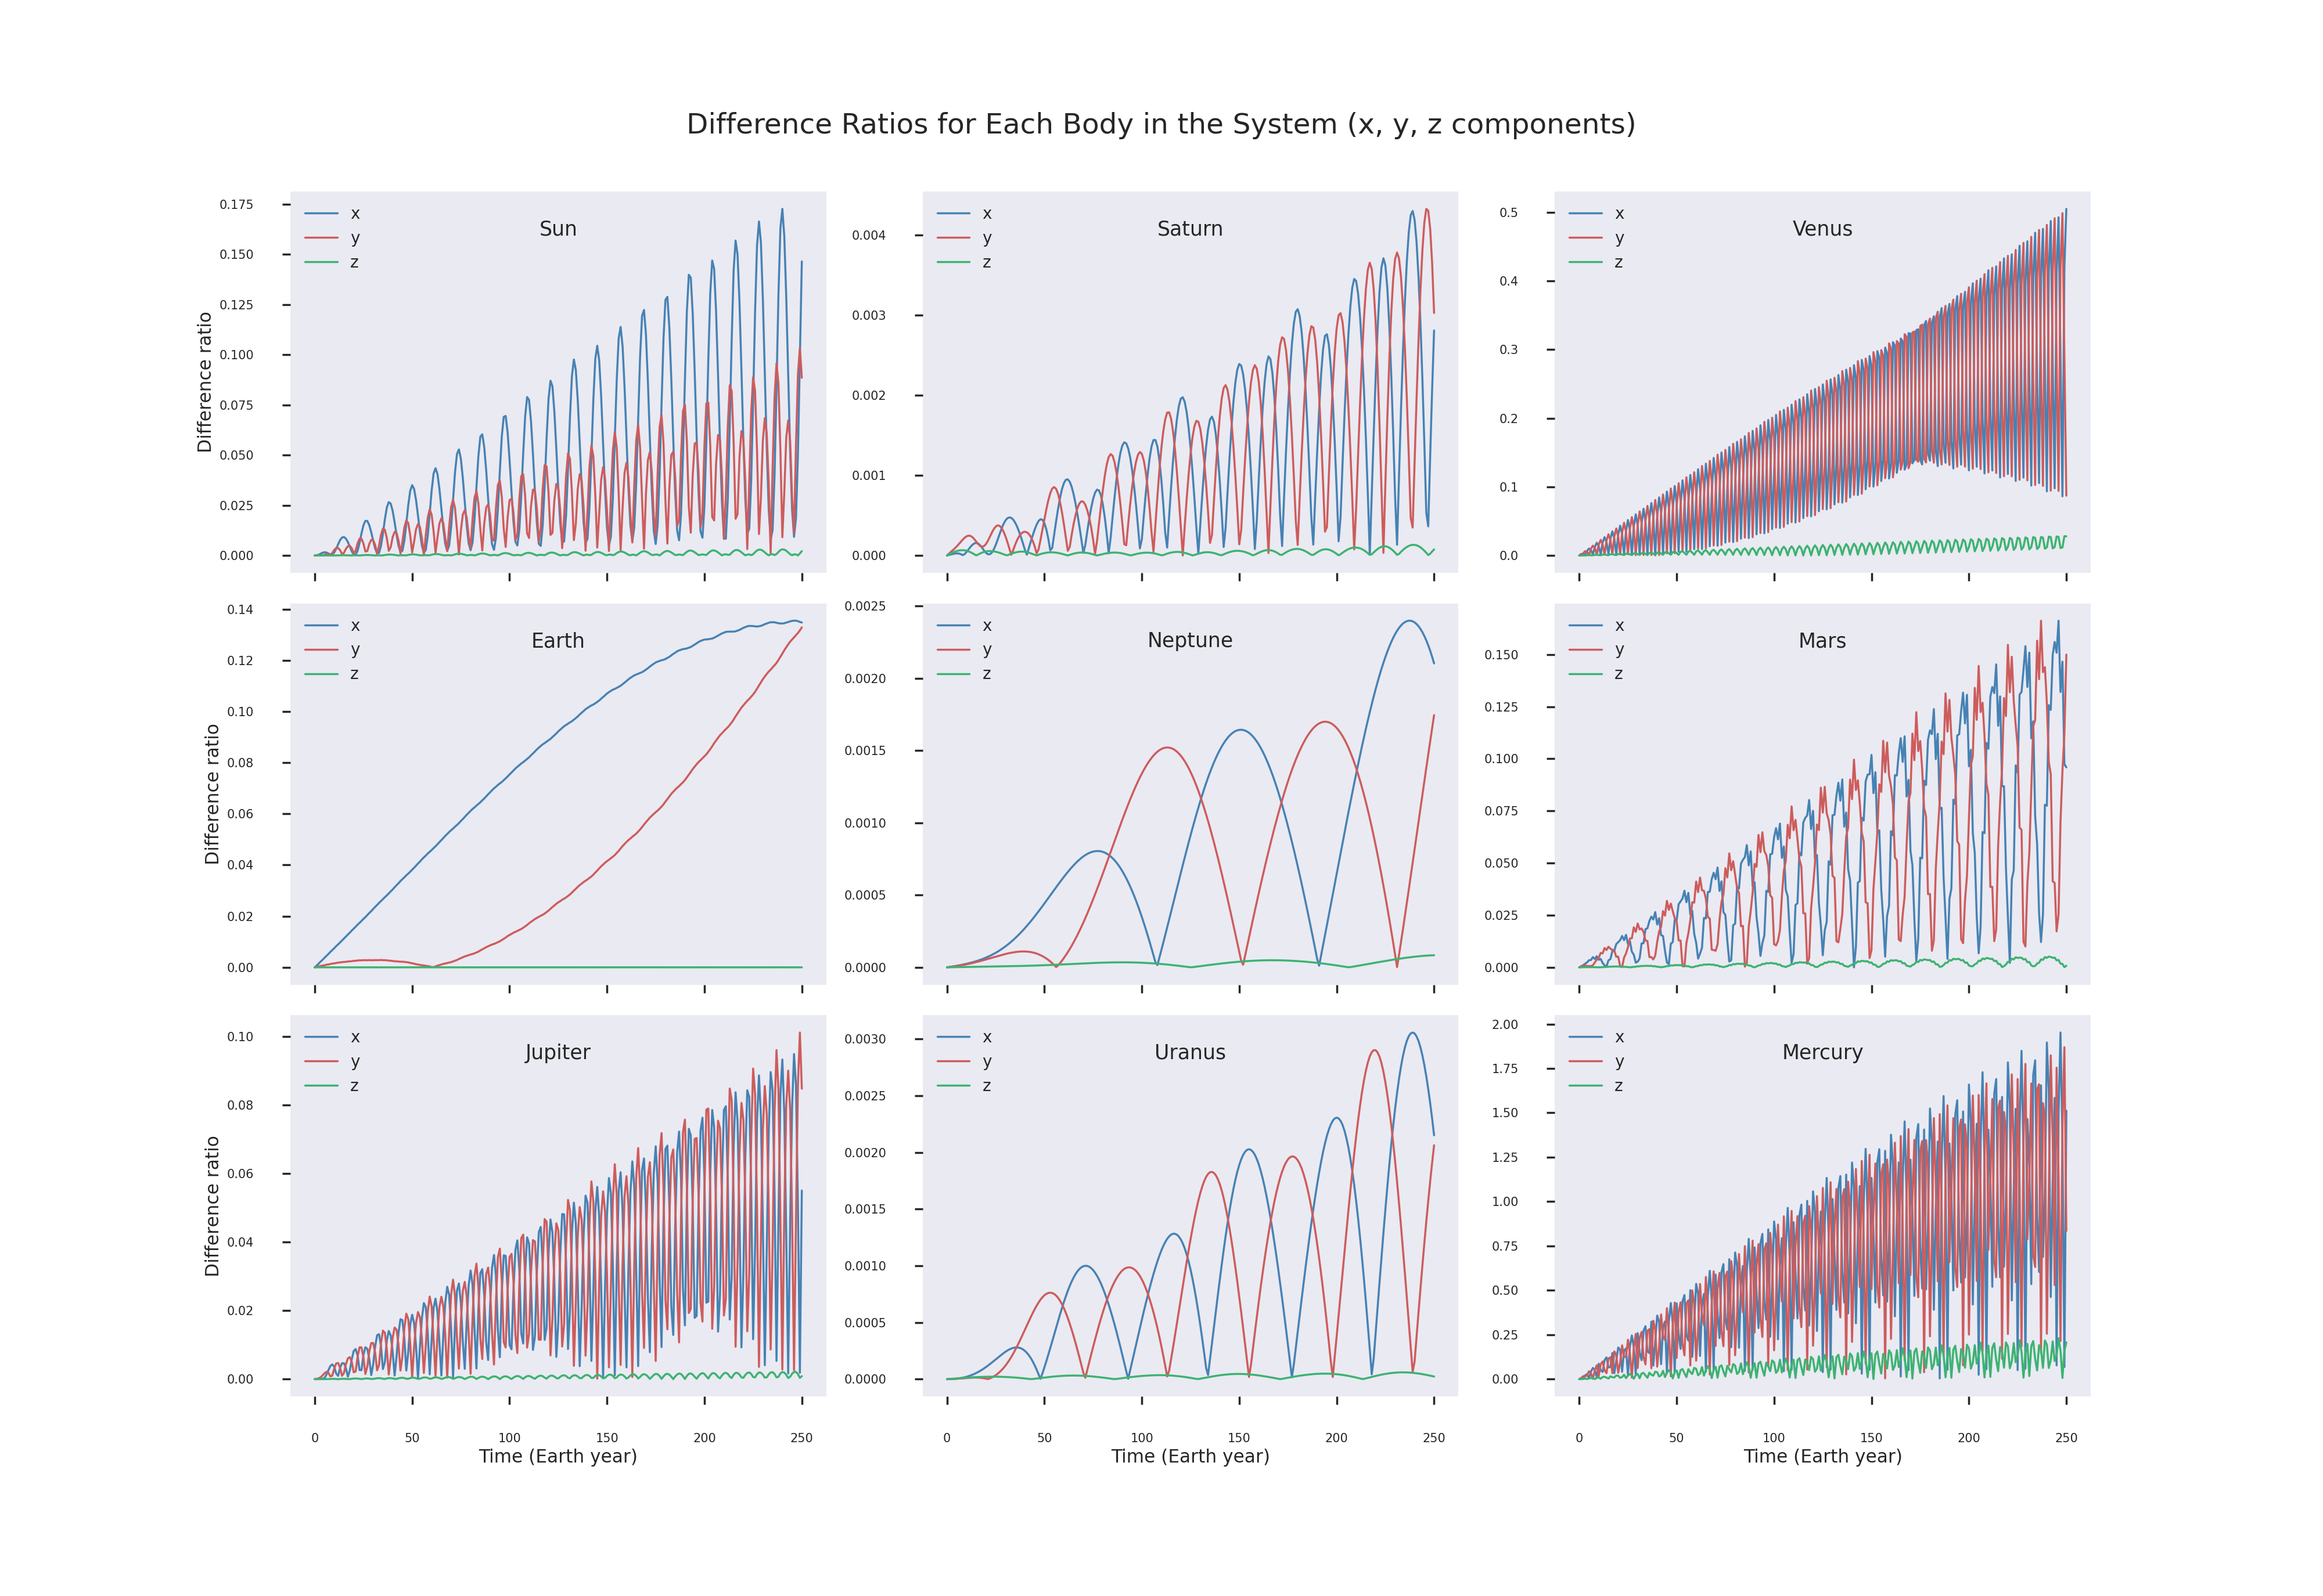
Analysis: Accuracy
Notes:
Define the different ratio
For each planet, for x, y and z components every Earth year and during 250 years
using results from a simulation with a 1 Earth day, time-step and Bulirsch-Stoer Integration method
In 8 plots (all except Earth plot), we observe oscillations with a general tendency to increase linearly. Earth does not show oscillations but can still be approximated linearly

Slide 12
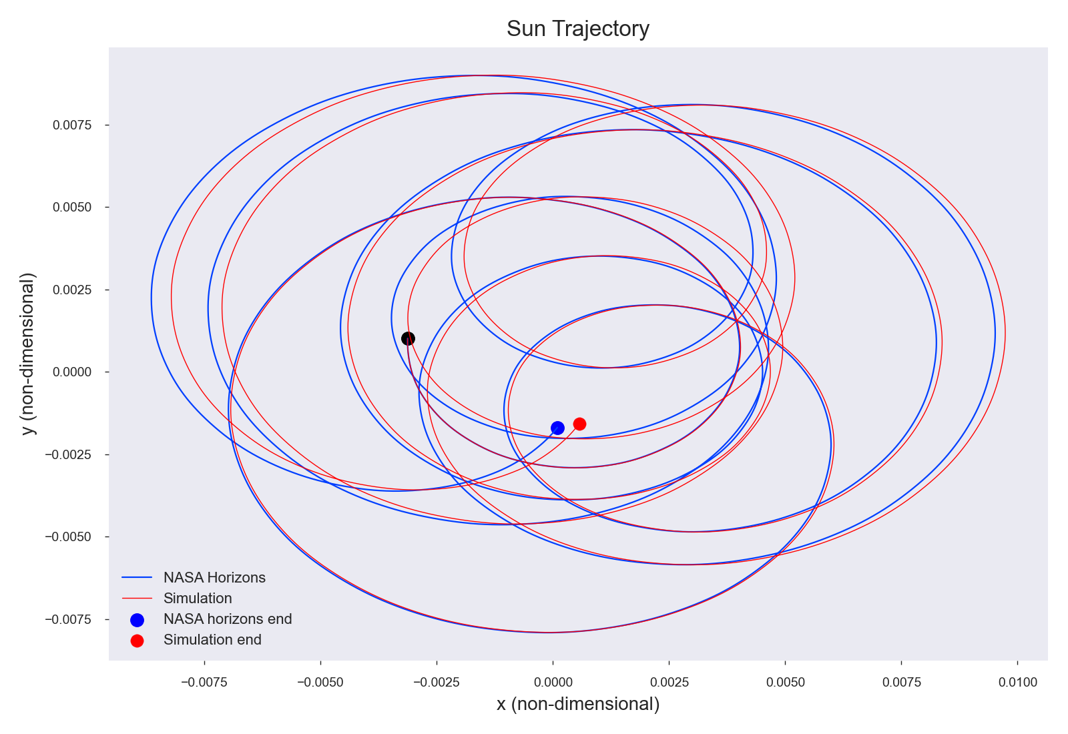
Analysis: Trajectory of the Sun
Notes:
Explain the oscillations! Sun trajectory
A first observation is that the Sun does not follow a specific orbit around the solar system barycenter. This is due to the fact that the barycenter, center of mass of all the 9 bodies orbiting each other in the solar system, evolves relative to the sun depending on where each planet is located.
In addition, this trajectory explains the oscillations in the different ratios for the the Sun. It can be observed that there are some points in which our simulation and NASA’s data are the same, whereas some where there is an increasing difference over time. This change in difference seems to be repeating itself with more and more different as time goes, which is exactly what is observed in figure 7. The same reasoning can be applied to other planets.

Slide 13
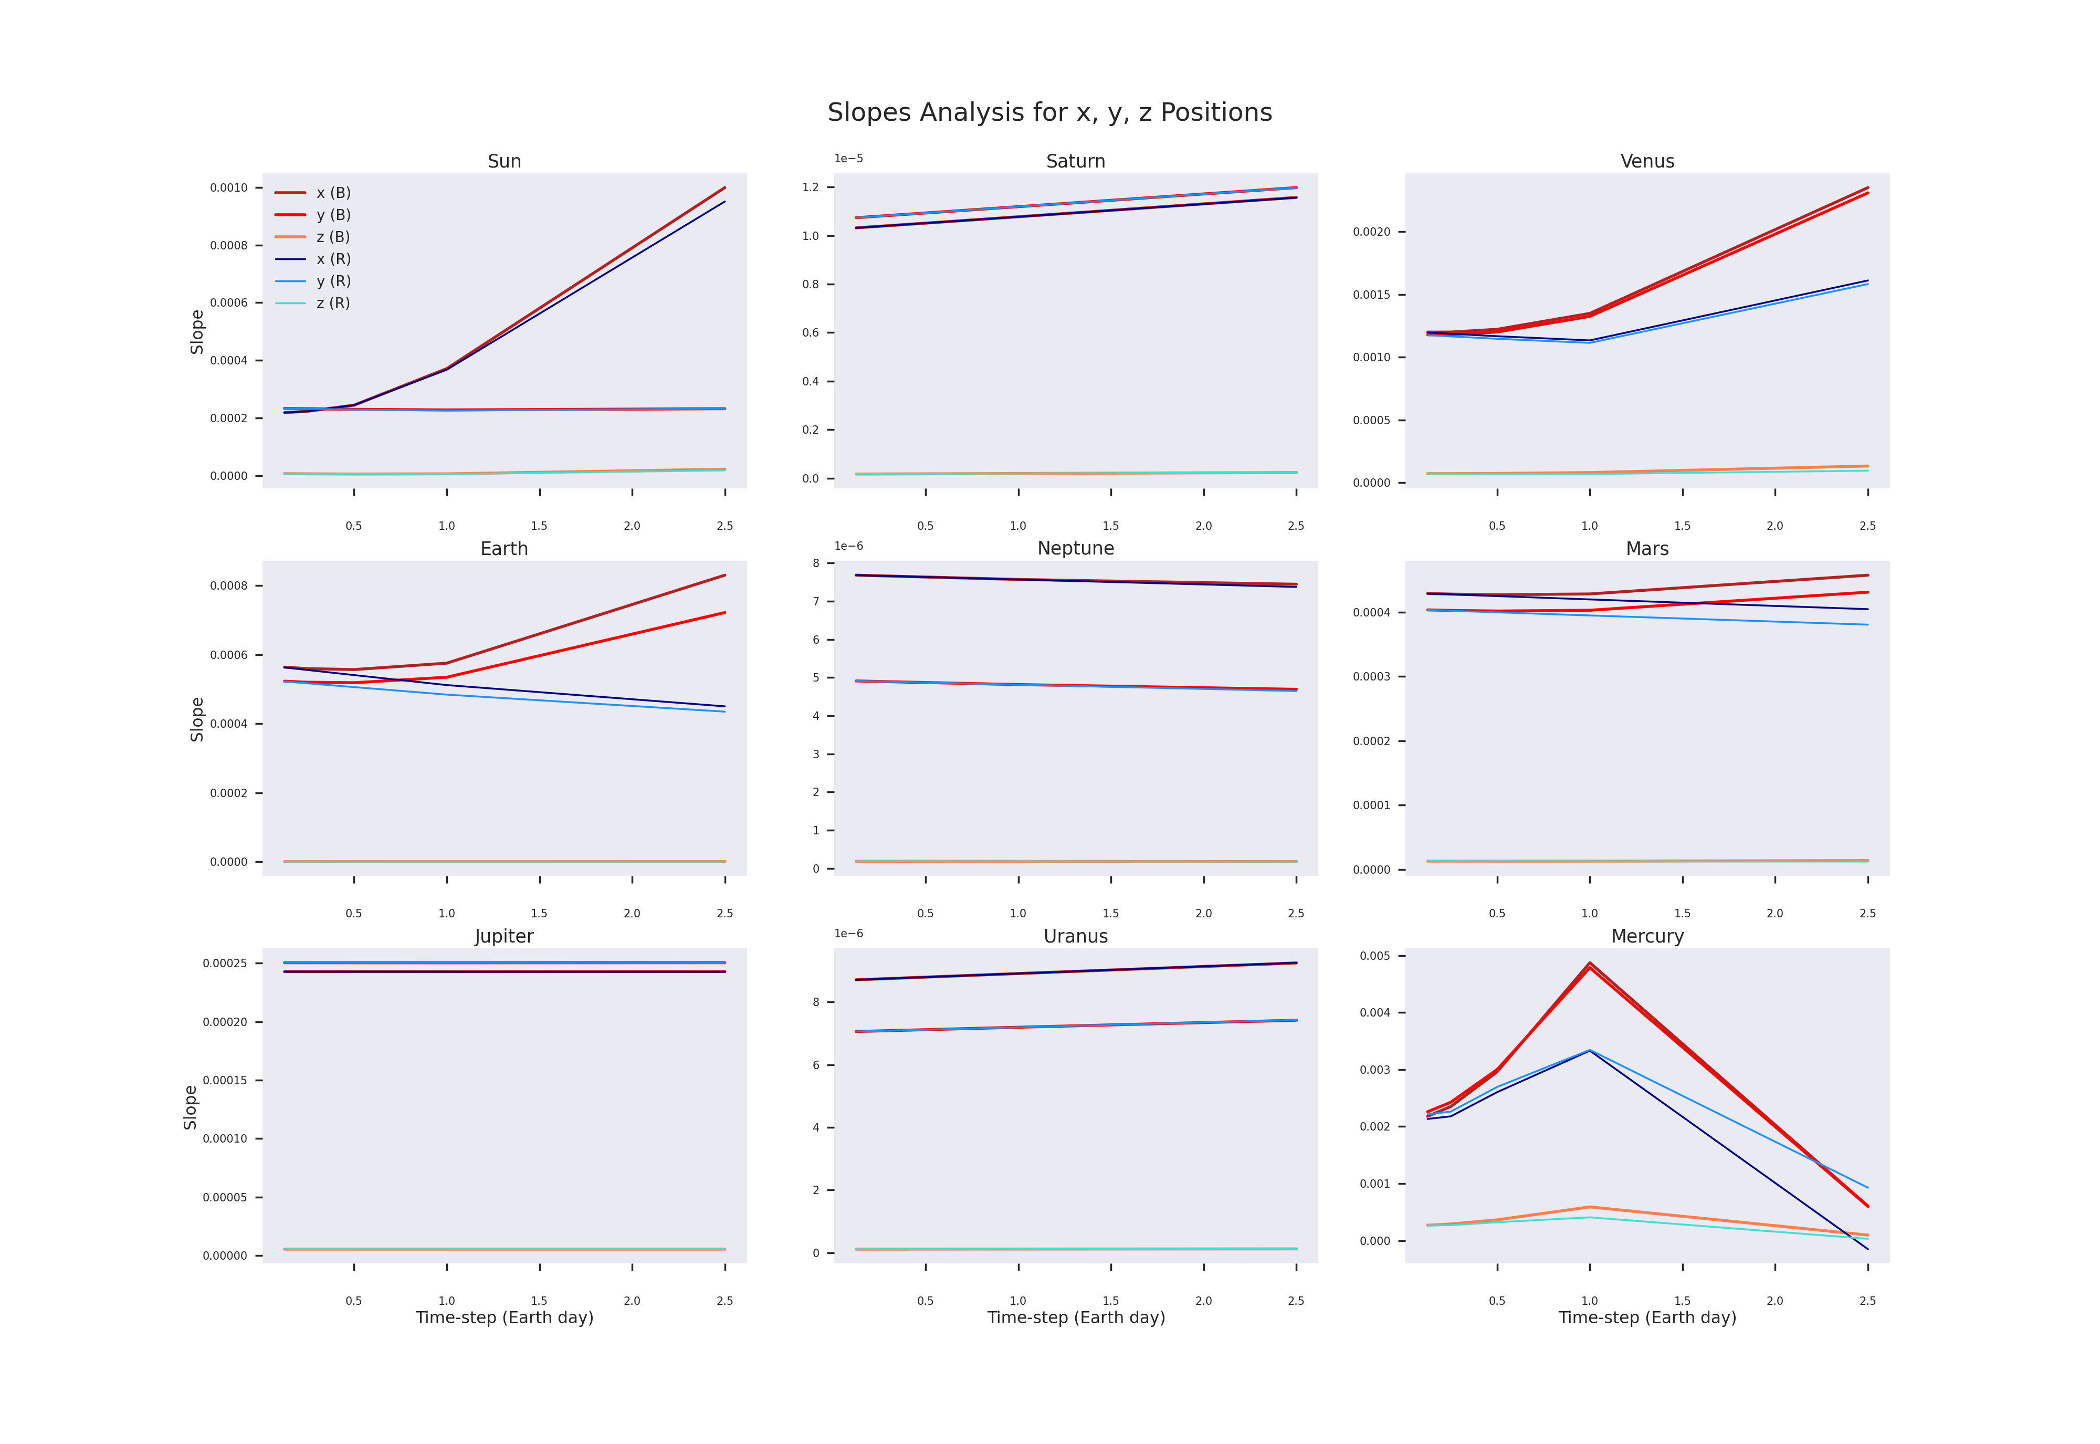
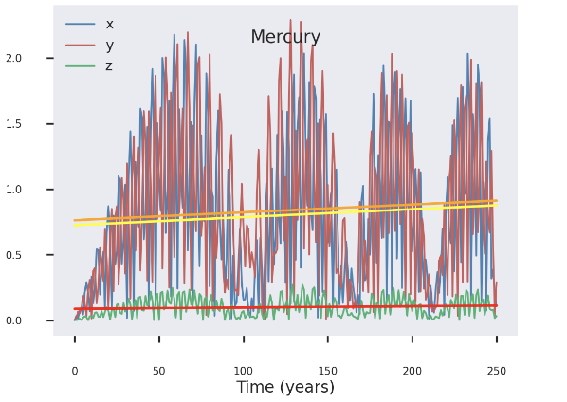
Analysis: Slopes
Notes:
Tendency of oscillations to increase with linear trend
used linear regression methods to calculate the slope which characterize the increase of the difference ratio over time, for each position component and each planet. In other words, the slope characterizes the accuracy of the simulation. A bigger slope means that the simulation becomes highly inaccurate in a fast time, while a low slope means that the simulation results are pretty similar to NASA’s Horizons data.
For smaller planets: using smaller timestep gives higher accuracy
Moreover, runga-Kutta more accurate but Bulirsch-Stoer manages to increase accuracy faster
For bigger planets, no change

Slide 14
Next Steps
Improve the implementation of Bulirsch-Stoer: choose an extrapolation method using a polynomial of a higher degree
Investigate why the accuracy is lower for the 4 innermost planets
Blender visualizations: use textures for planets and automate the process
Simulate for bigger timespans and with moons

Slide 15
